Slide 1

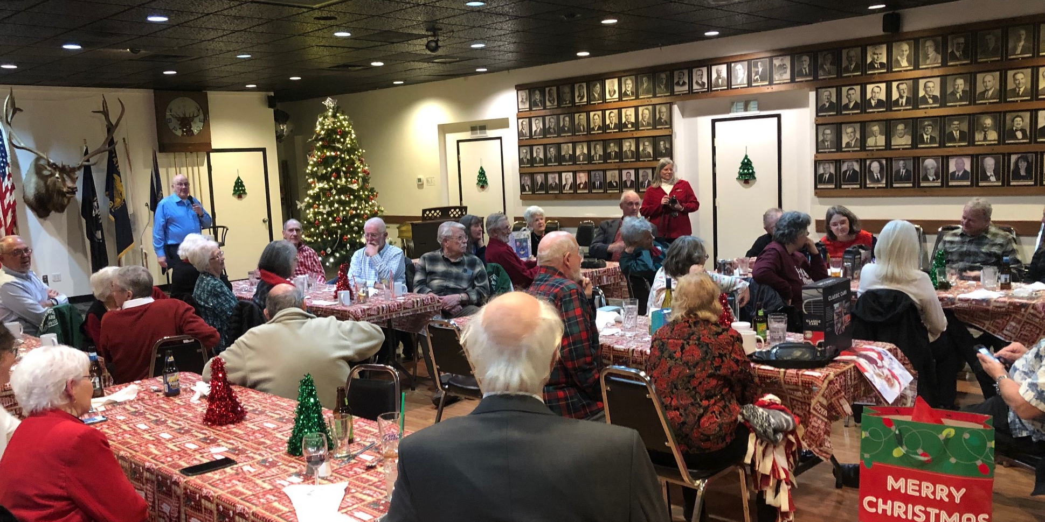

2021 EEVAC Christmas Party at Eugene Elks club

Slide 2
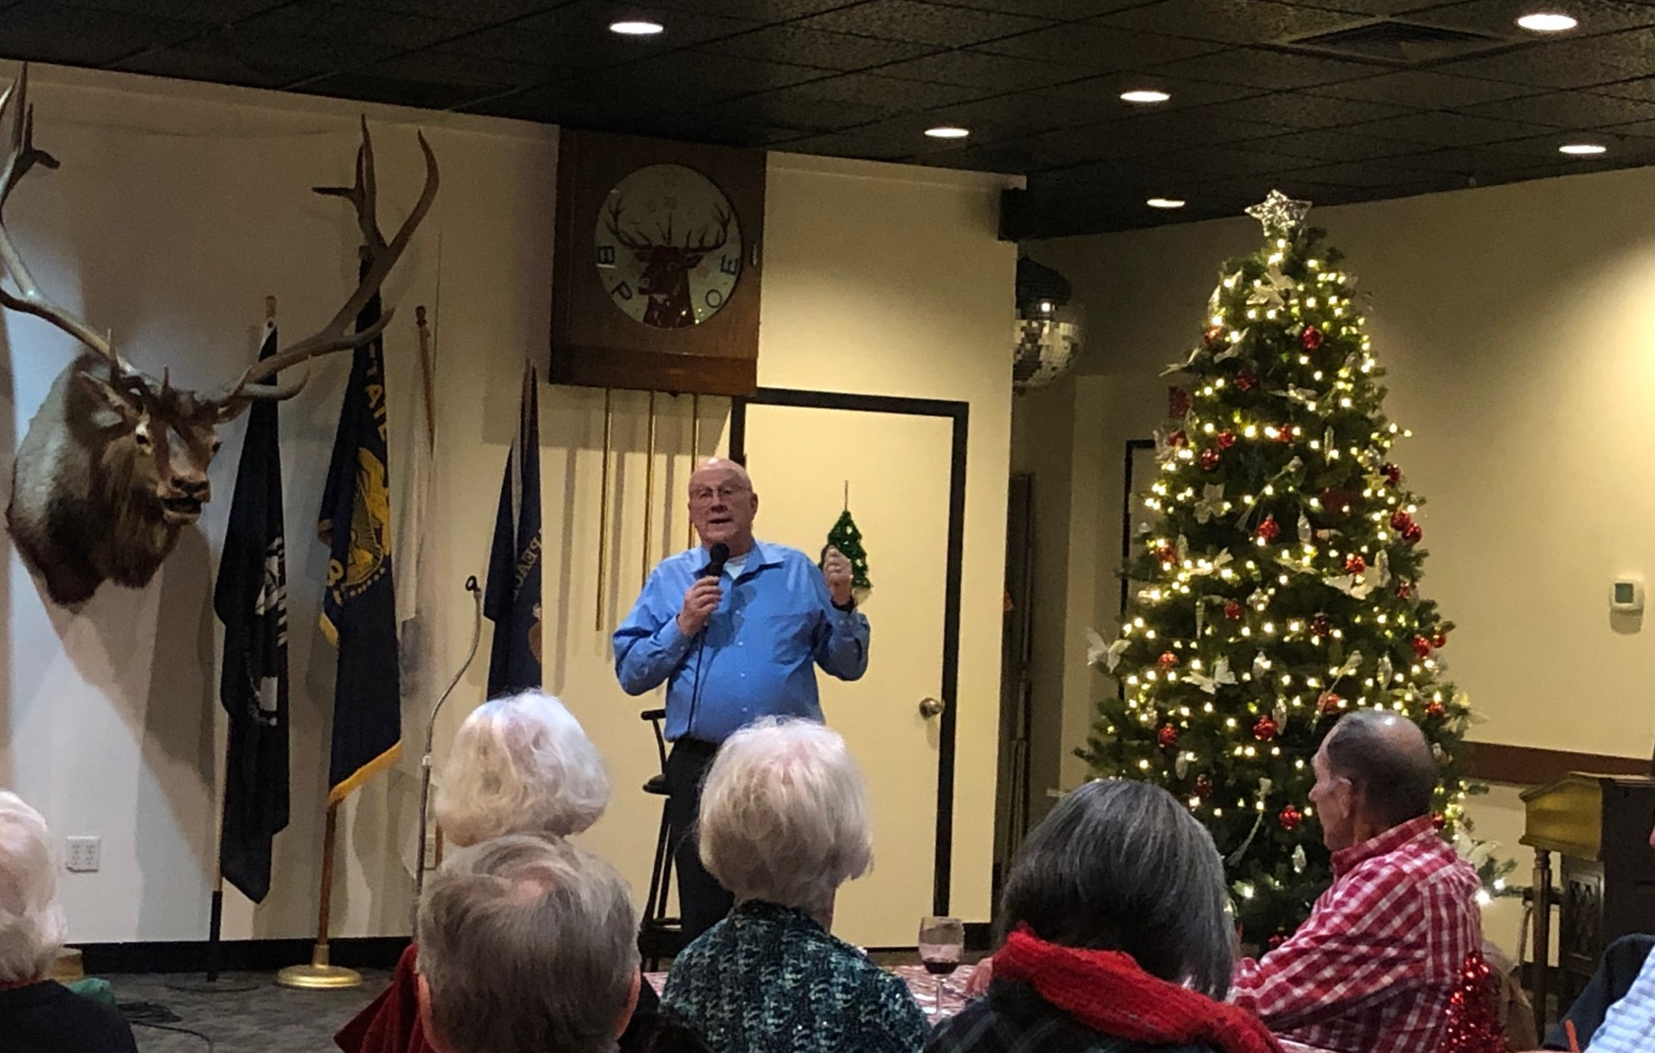
EEVAC Christmas Party
The Master of Ceremonies was Byron Inman

Slide 3
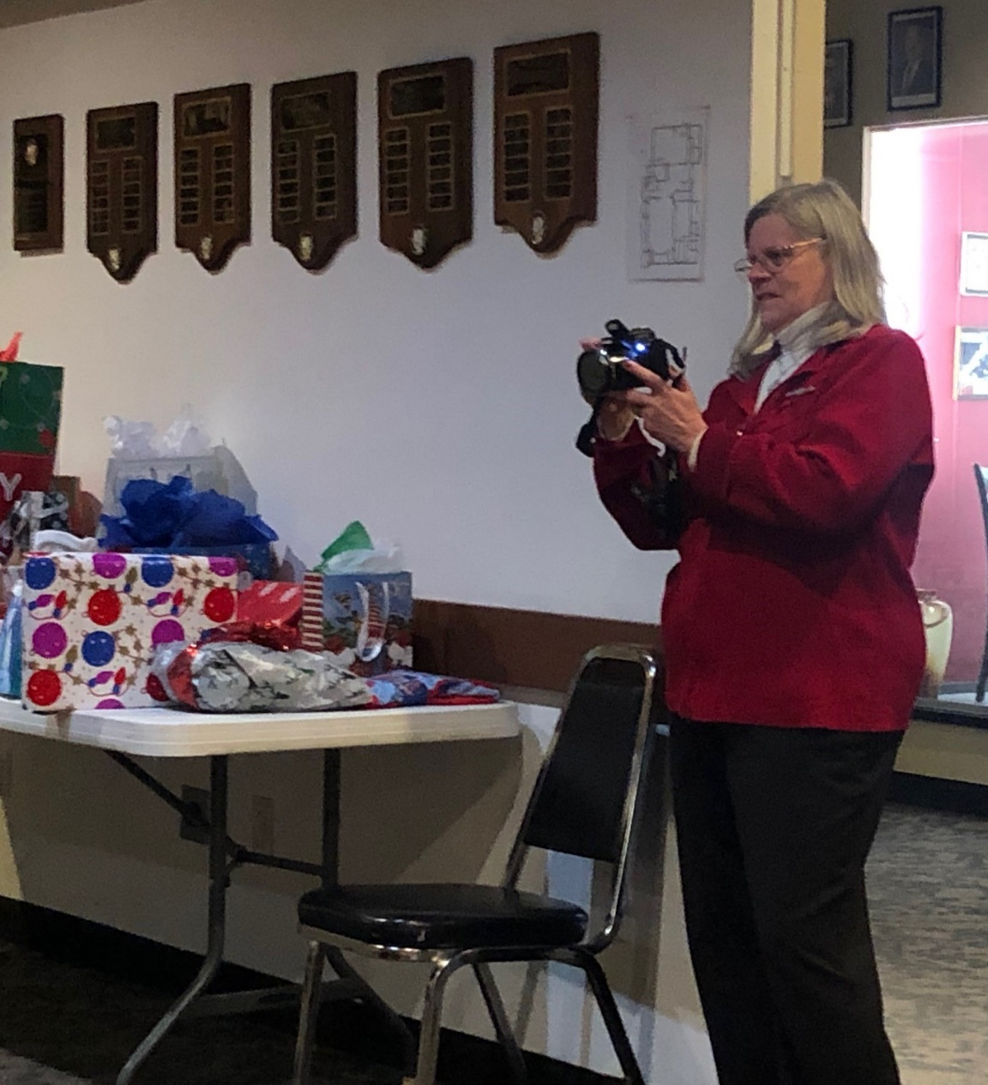
Ann Heckert was the photographer

Slide 4
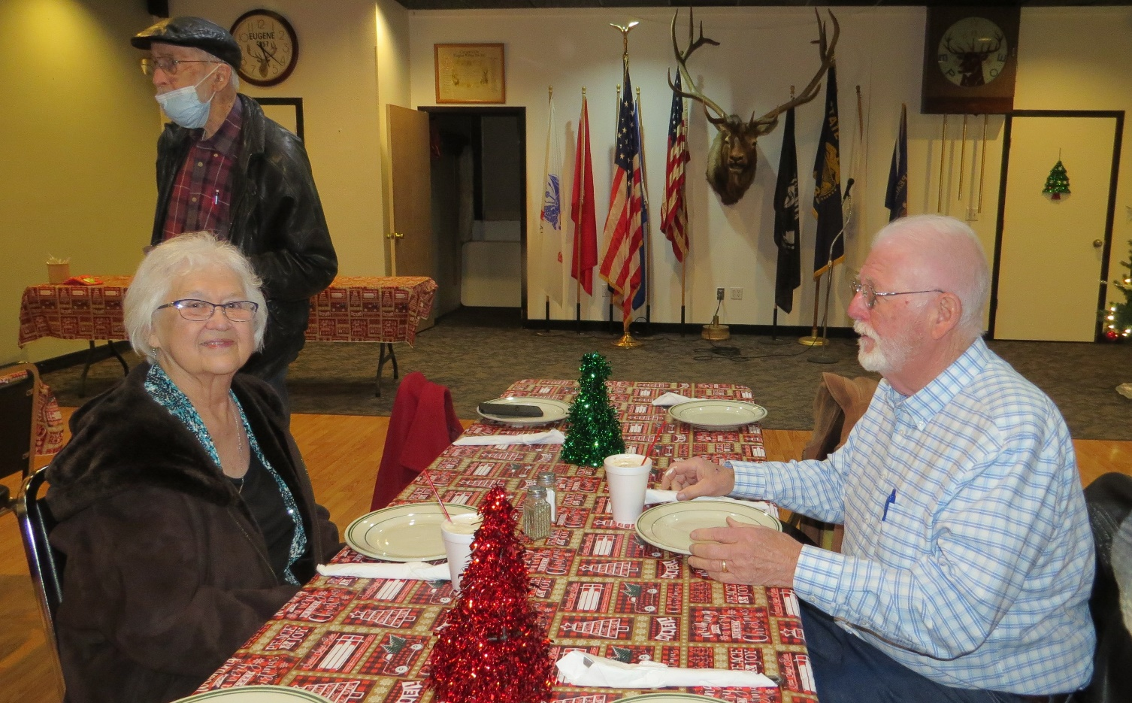
George’s ready for Christmas Dinner

Slide 5
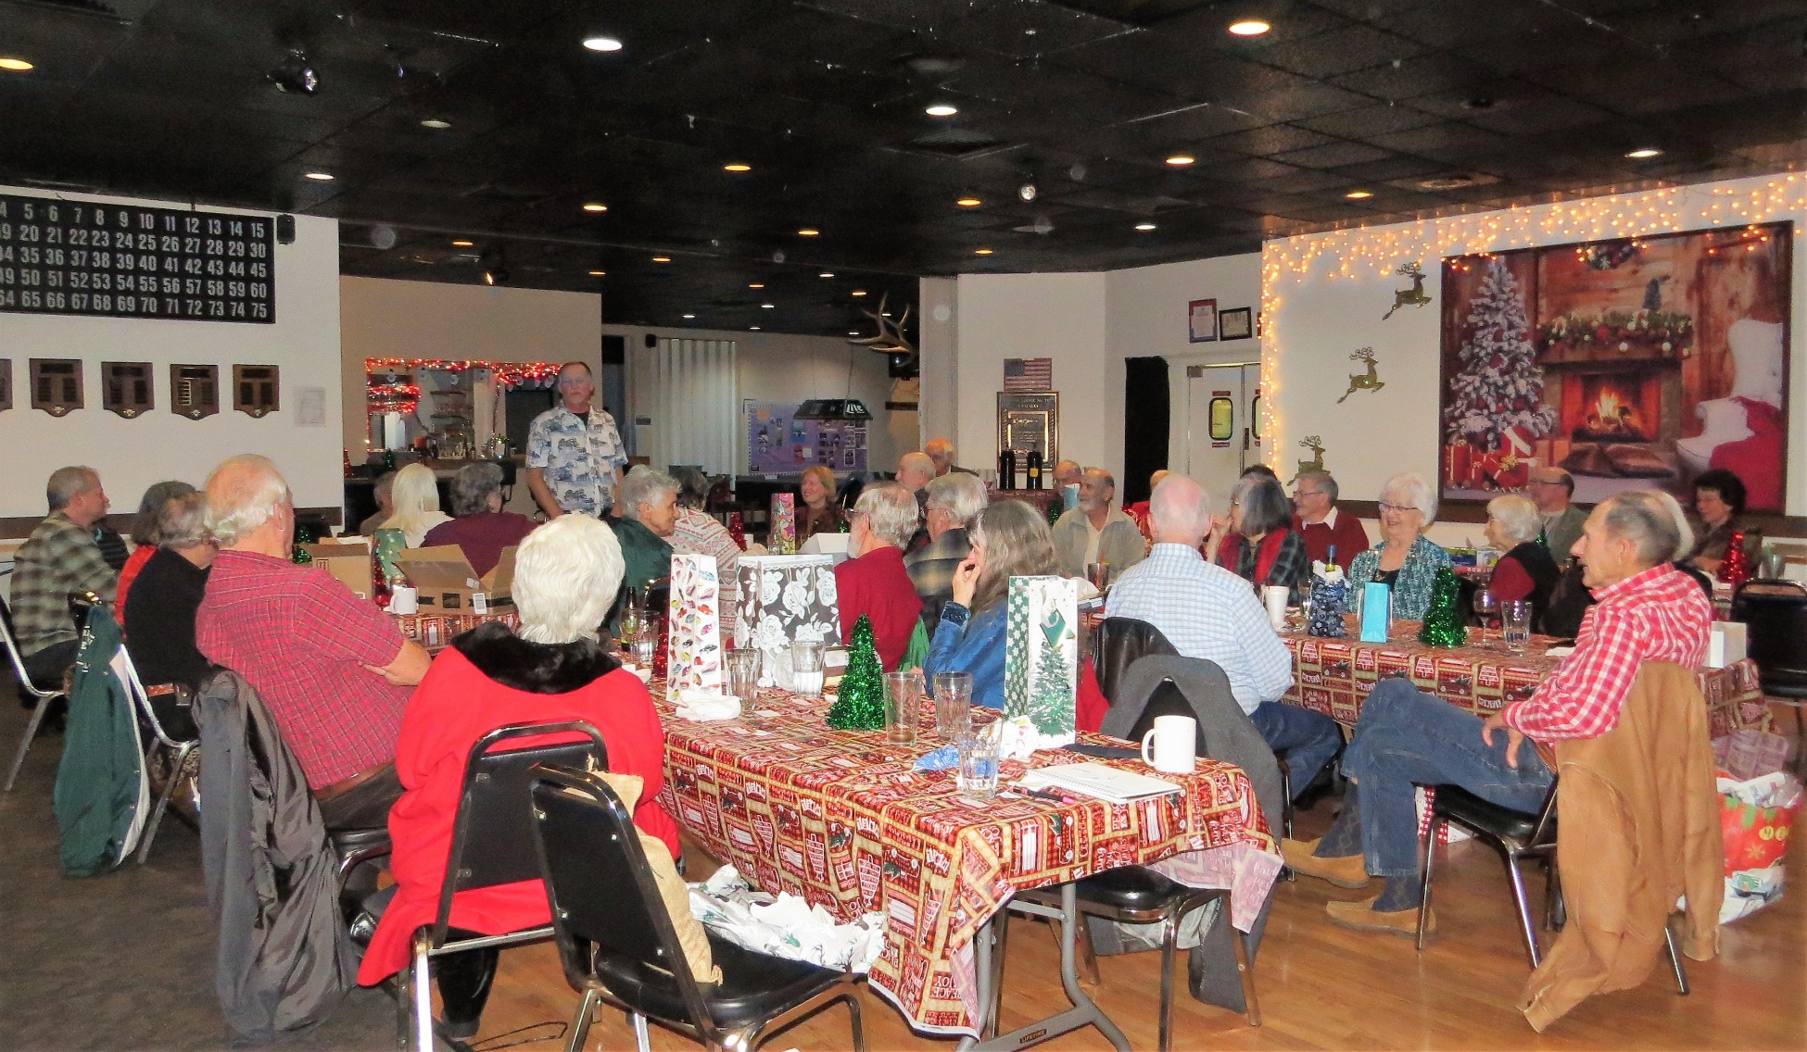
EEVAC Christmas Party
After a nice Buffett dinner, it was time to exchange gifts

Slide 6
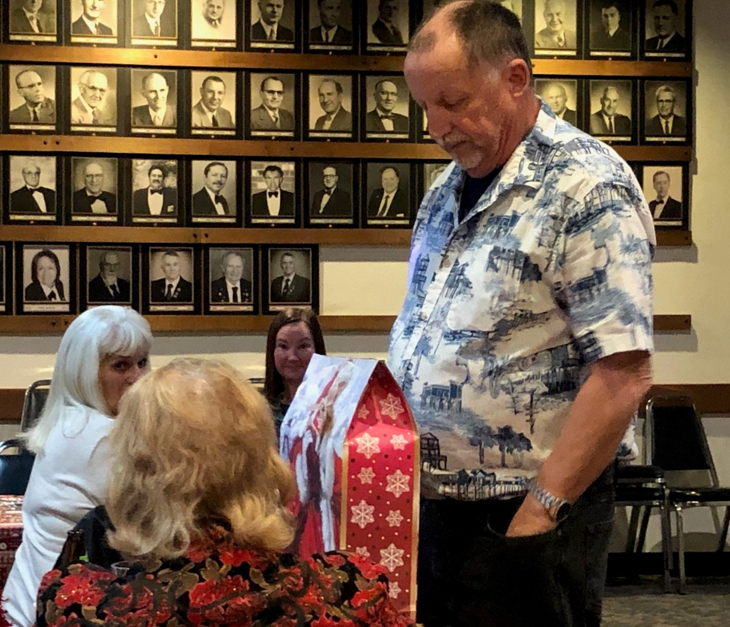
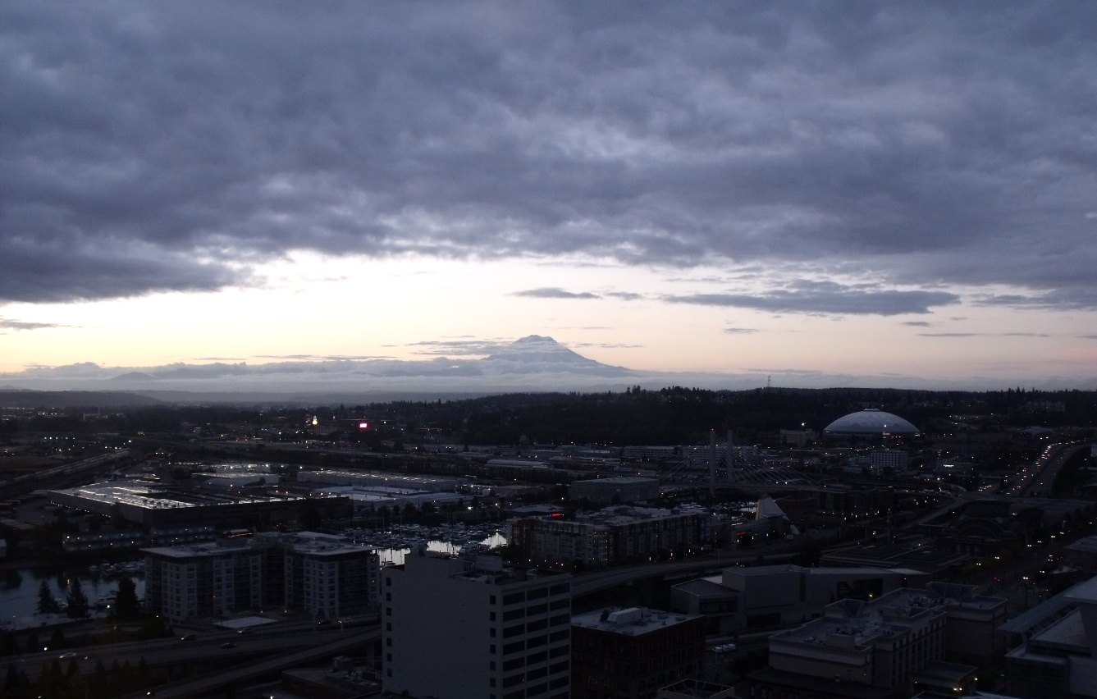
Charles is about to see what he picked

Slide 7
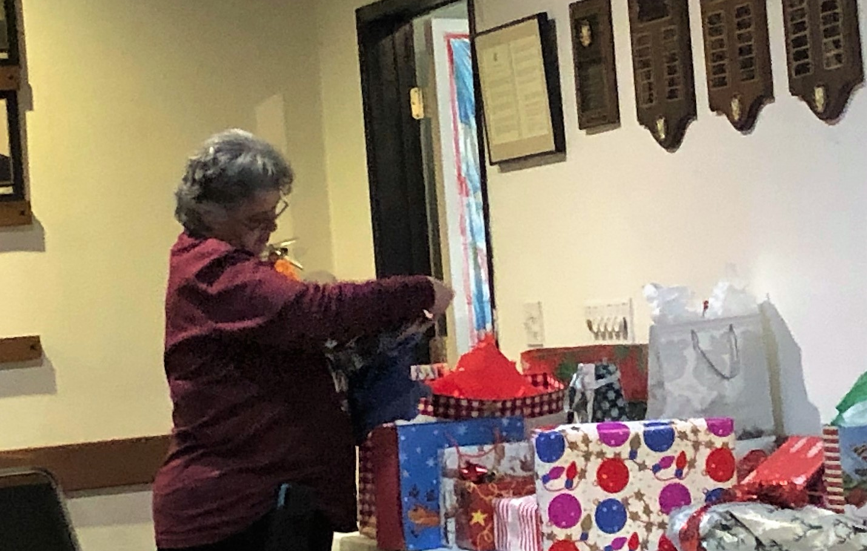

Slide 8
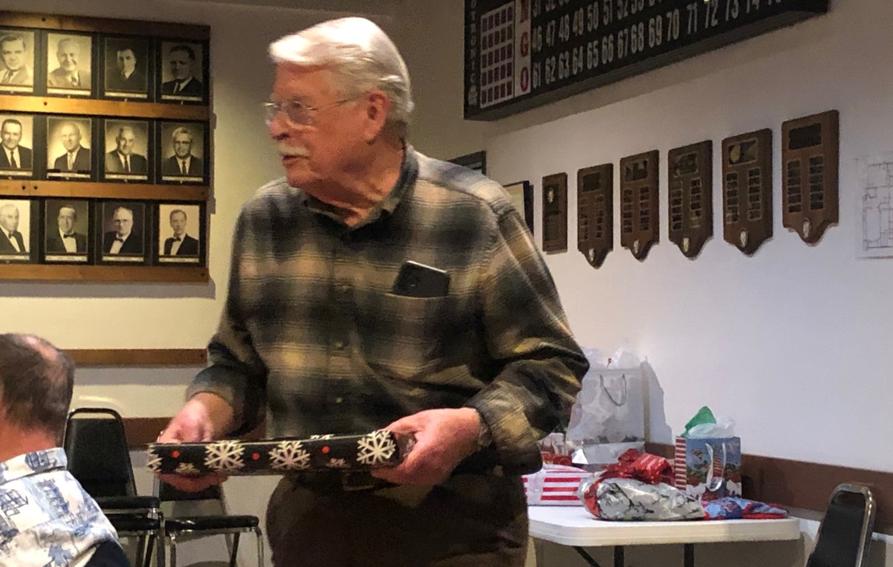
Mike making his escape with present in hand..

Slide 9
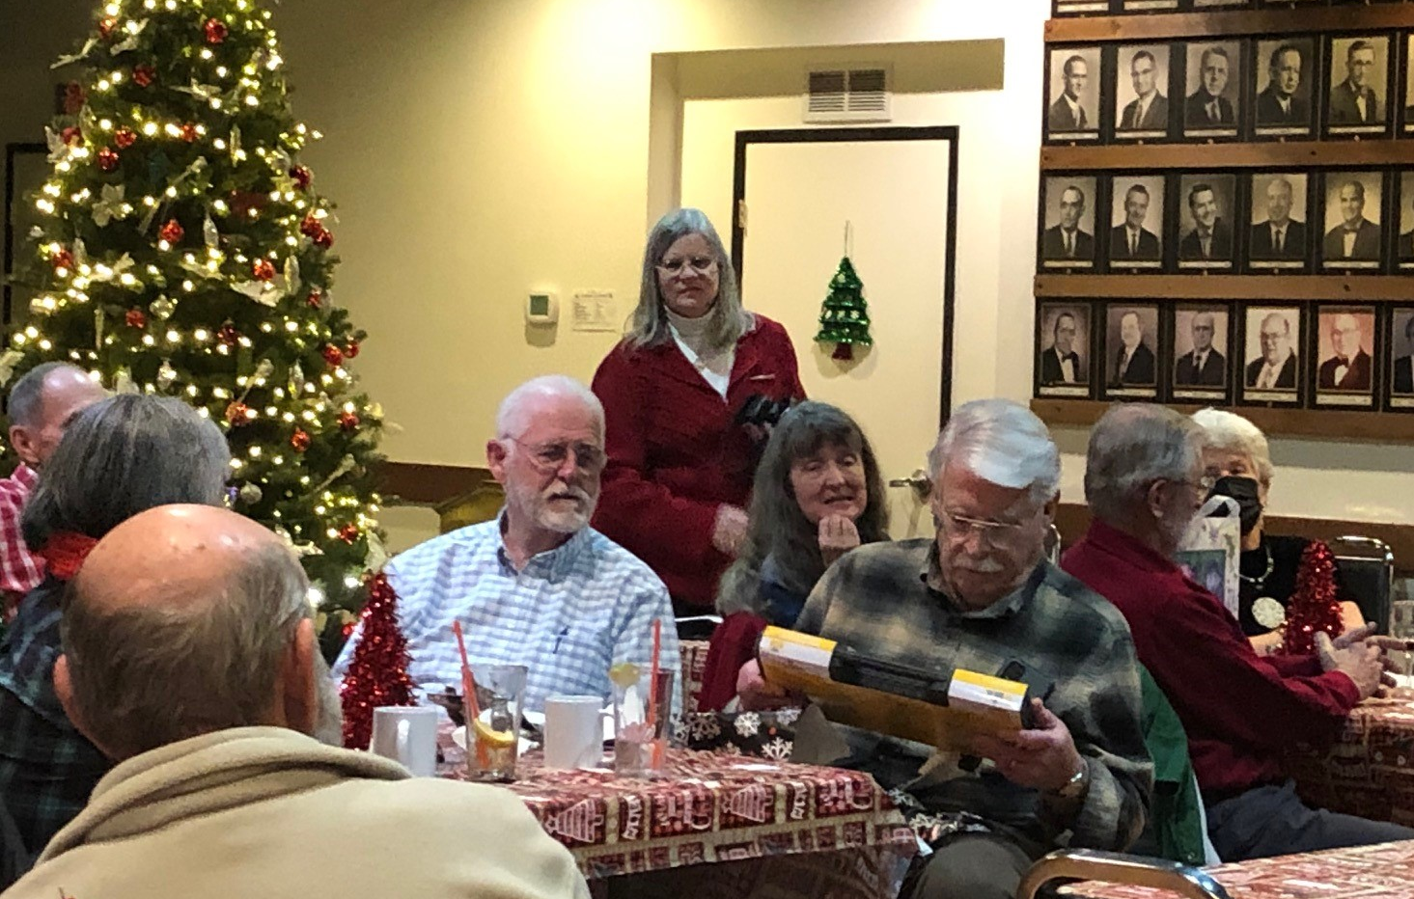
Now to check out his pick

Slide 10
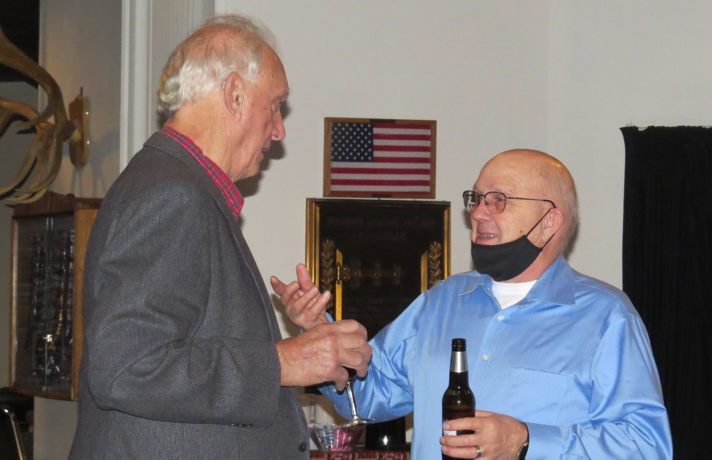

Slide 11
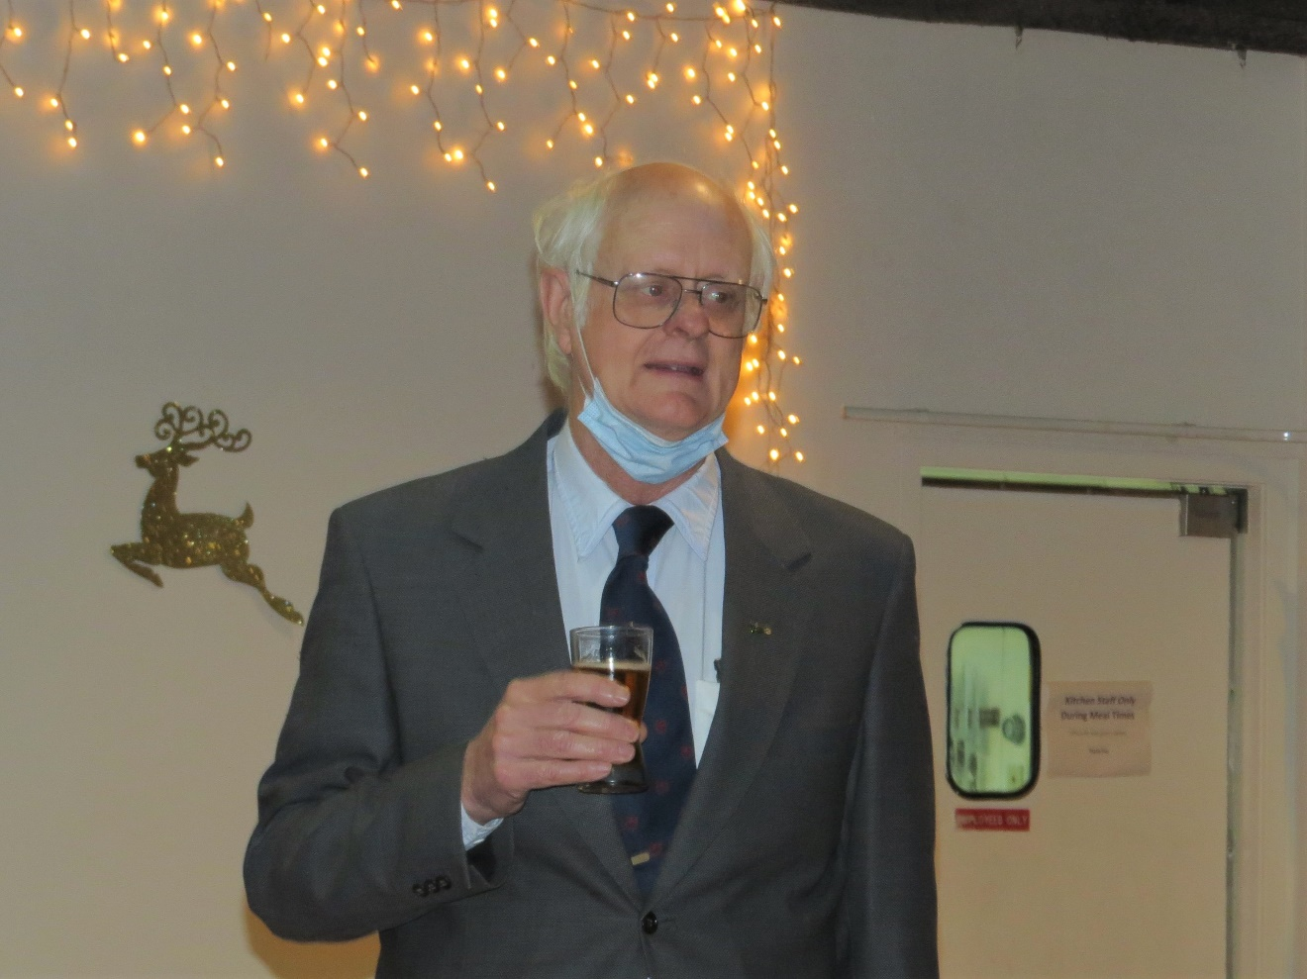

John amongst the stars..

Slide 12
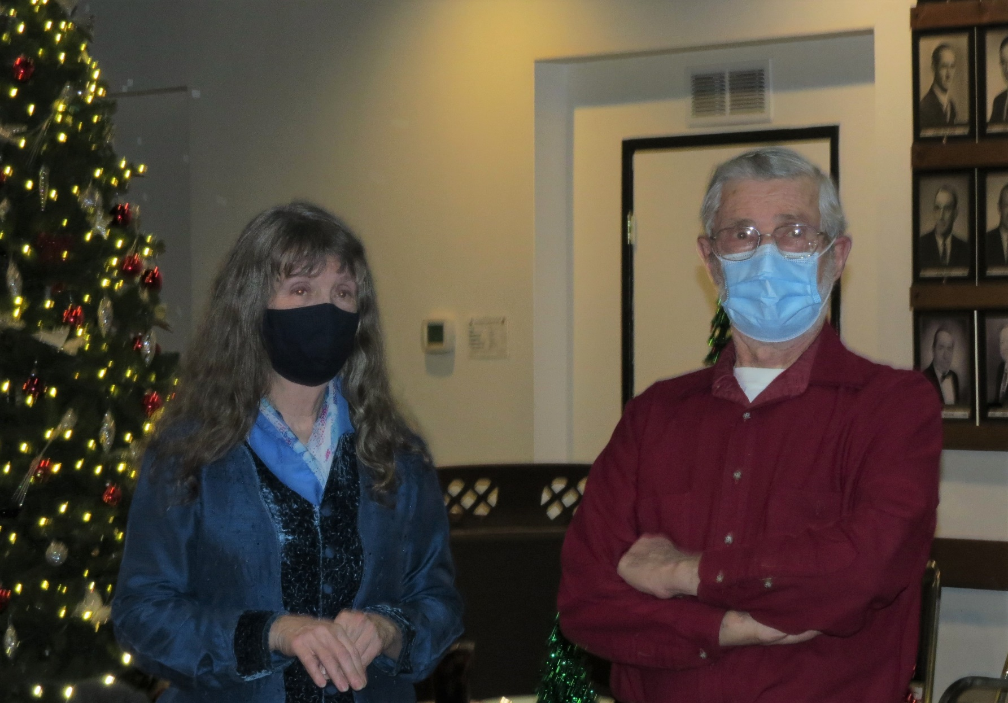

Slide 13
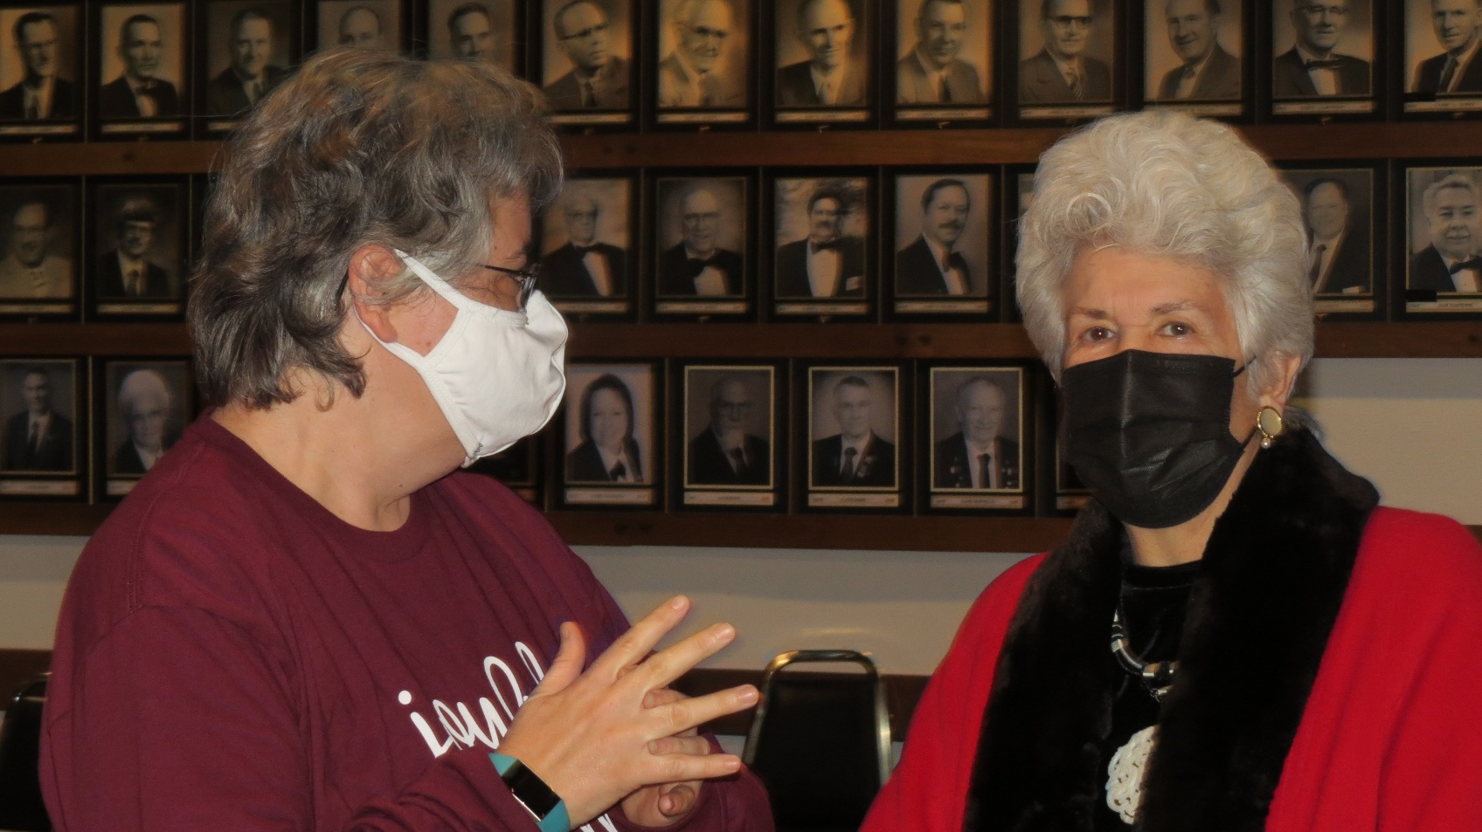

Slide 14
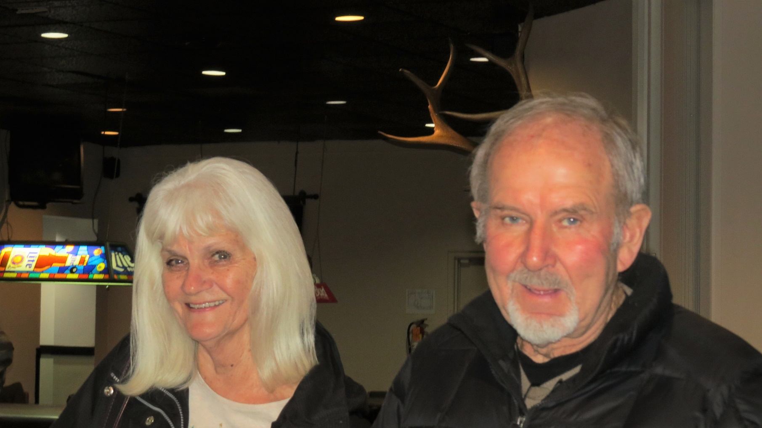

Slide 15
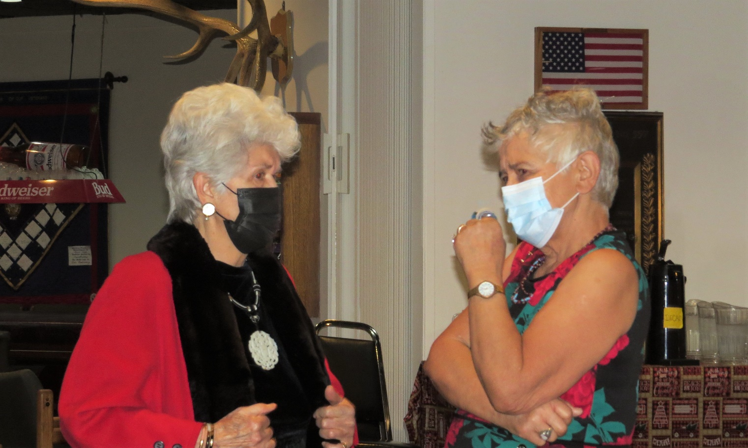

Slide 16
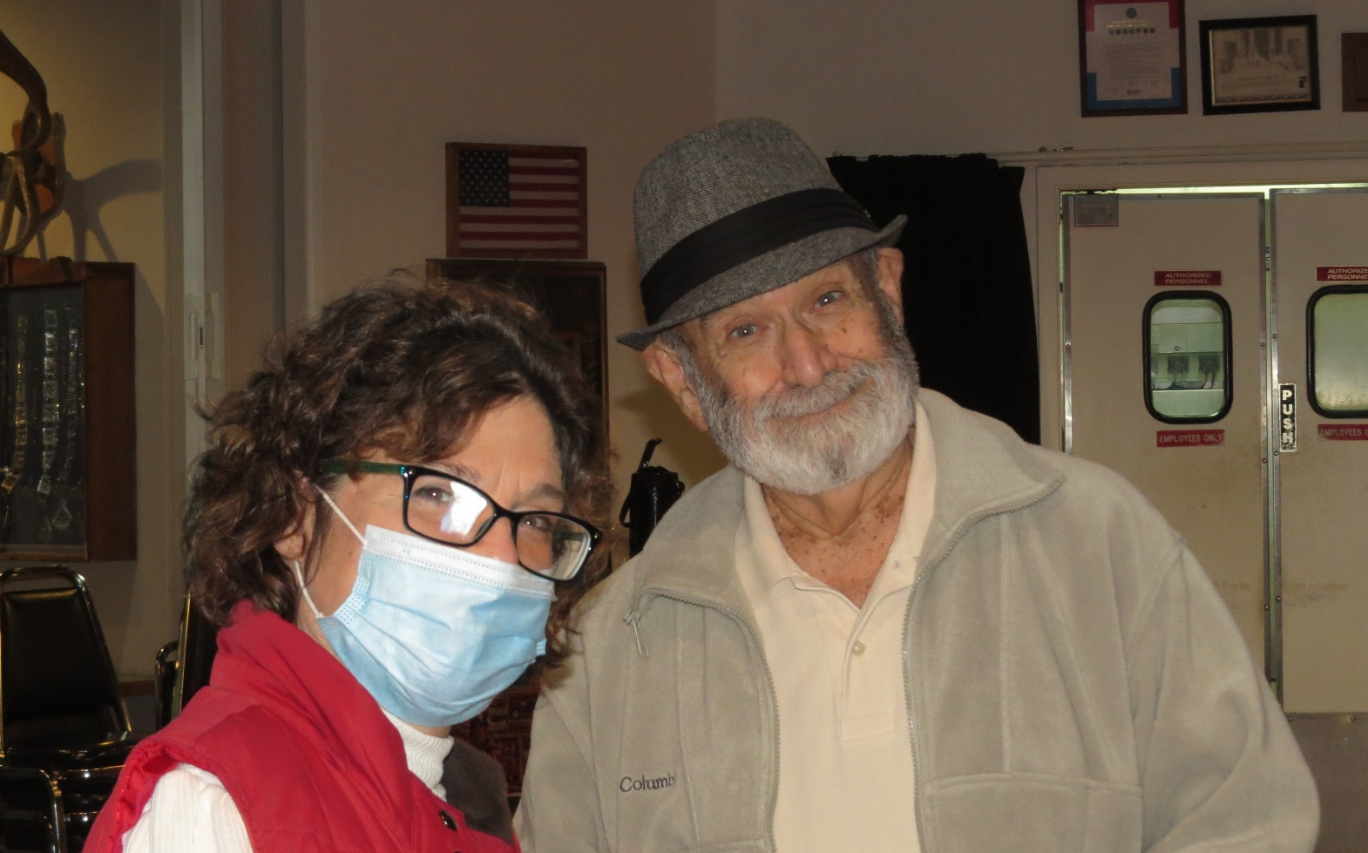
Rudy with his daughter

Slide 17
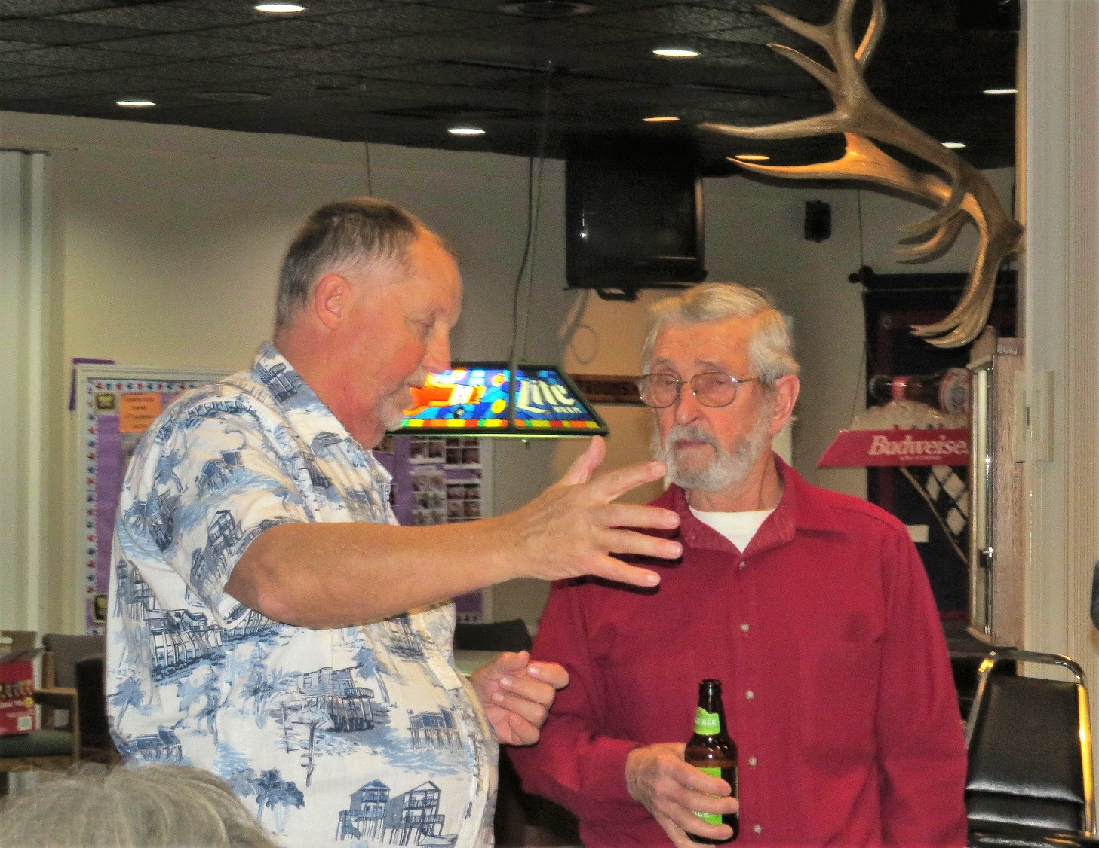
Charles in deep conversation with Jerry

Slide 18
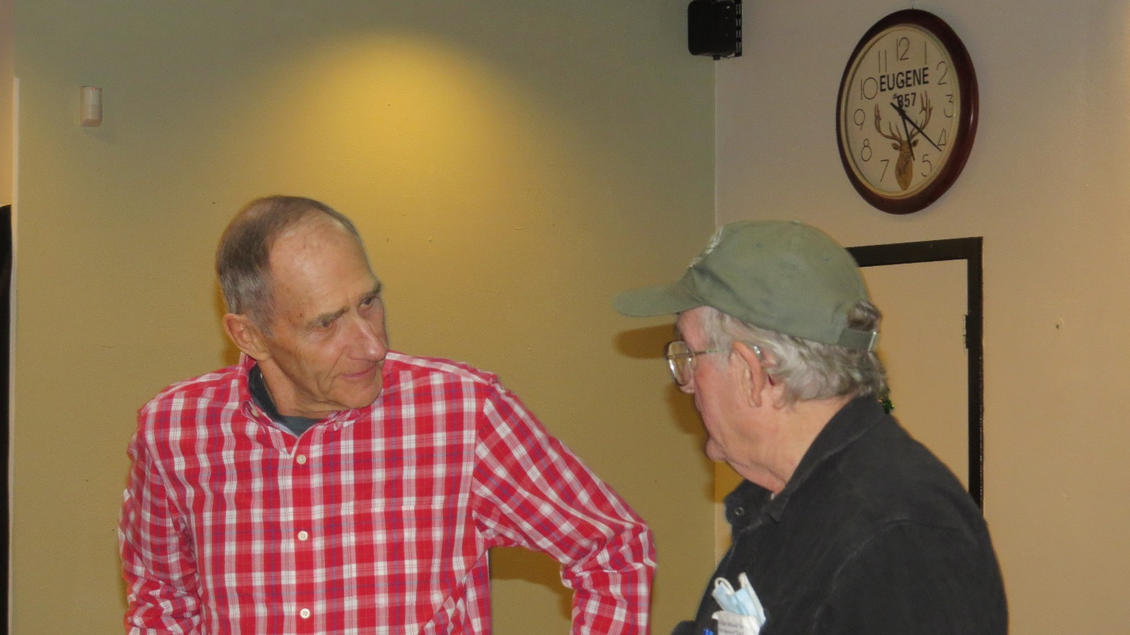

Slide 19
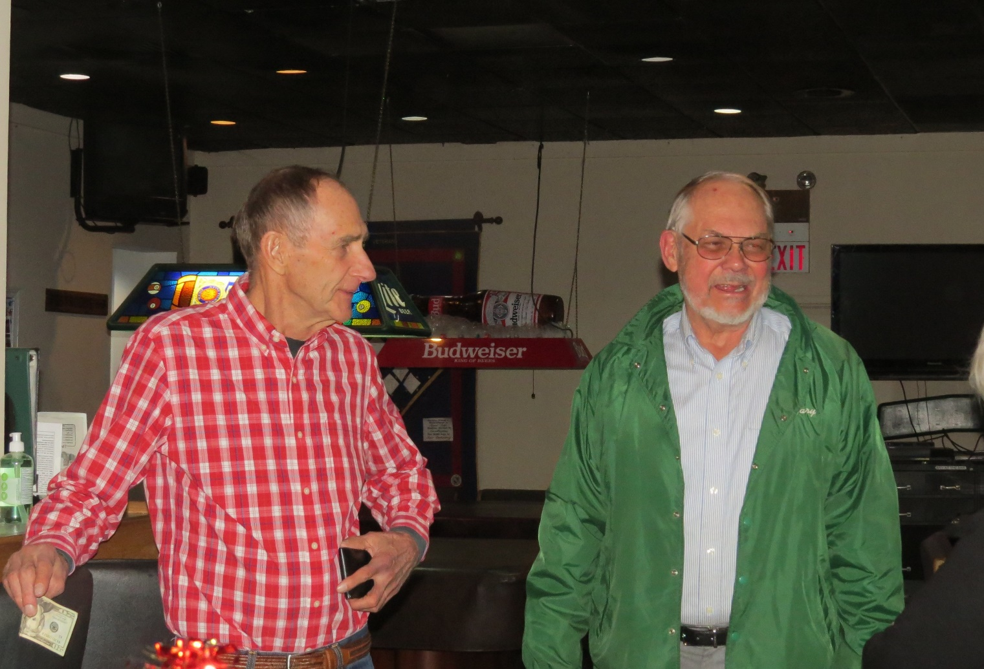

Slide 20
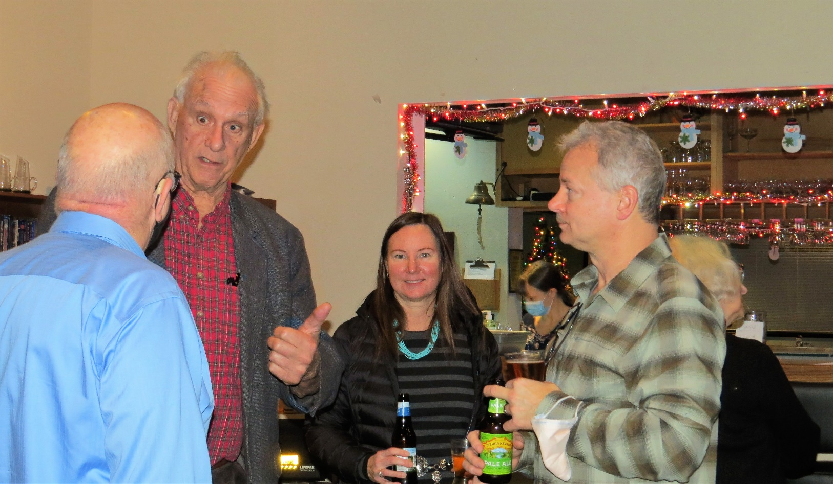

Slide 21
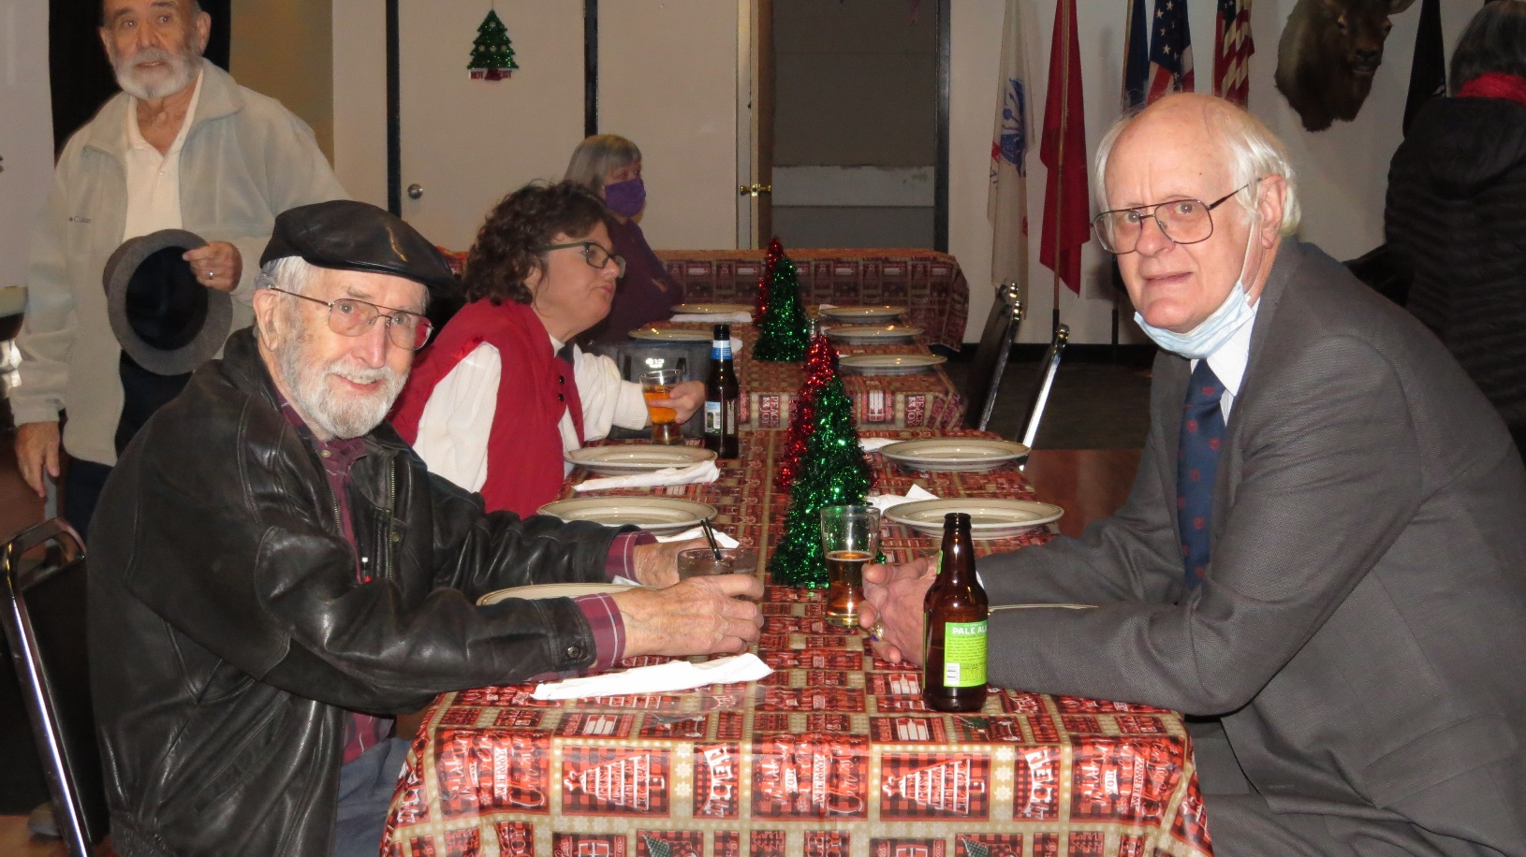

Slide 22
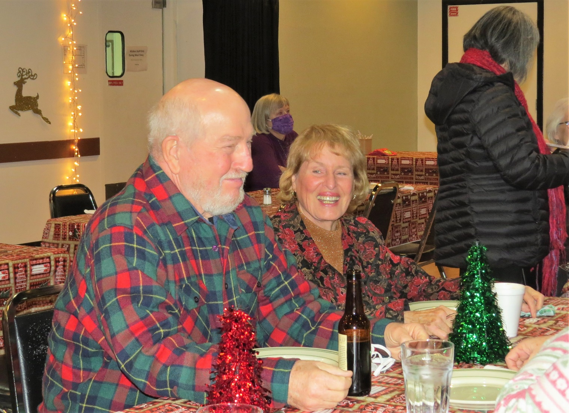

Slide 23
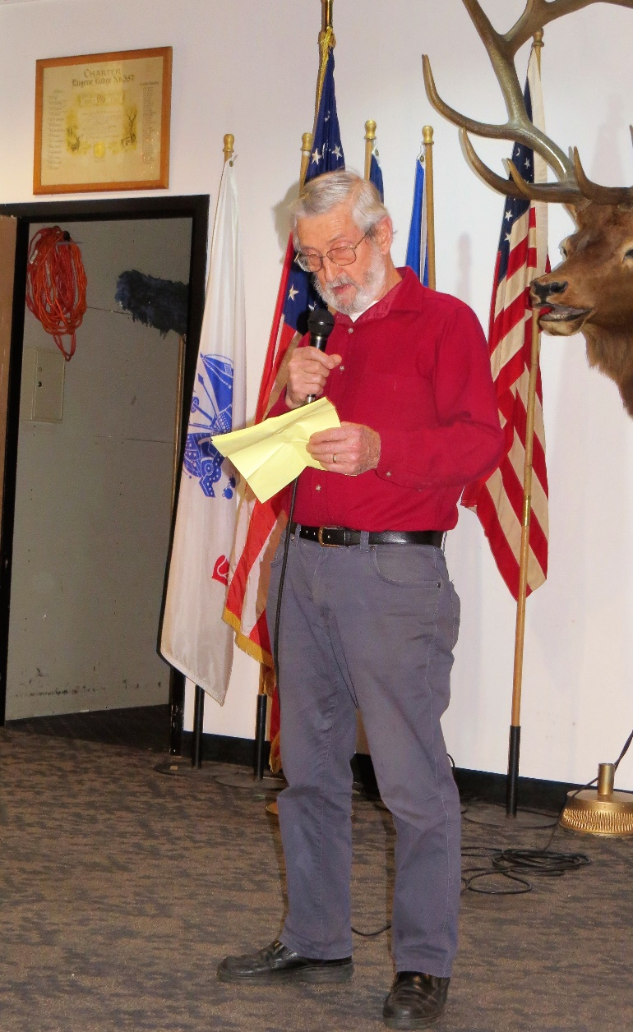
Emeril Empire Vintage Auto Club
Then & Now
by Jerry Berg
Jerry is one of the founding members EEVAC and did a presentation of the history of EEVAC and how it has grown through the years.
Very enjoyable!

Slide 24
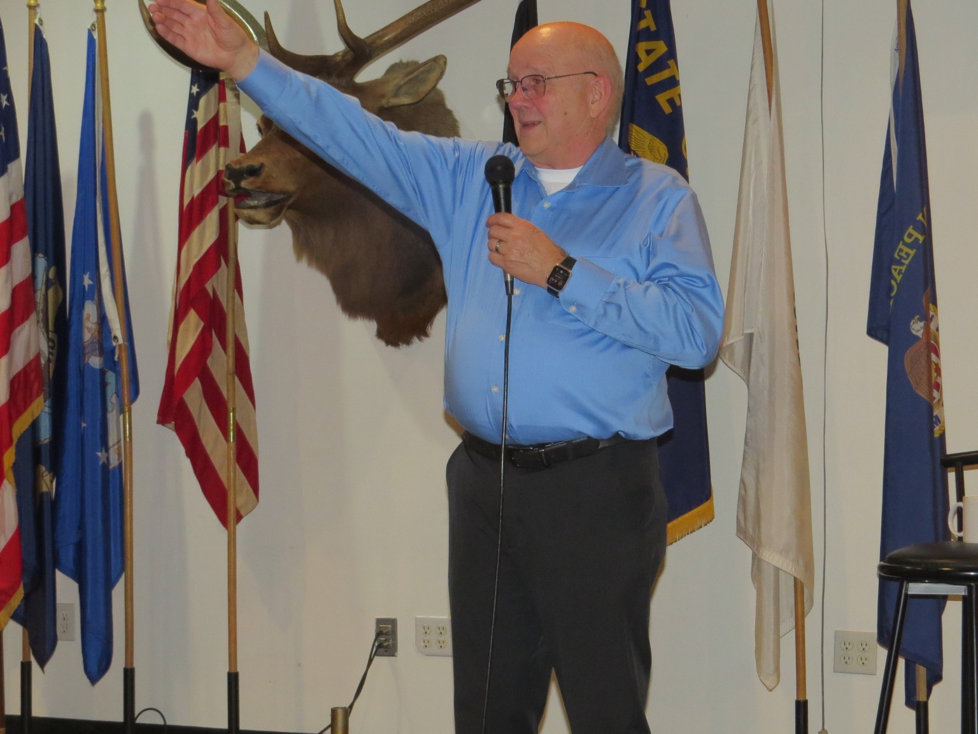
Our Mr. MC hard at work calling out numbers

Slide 25
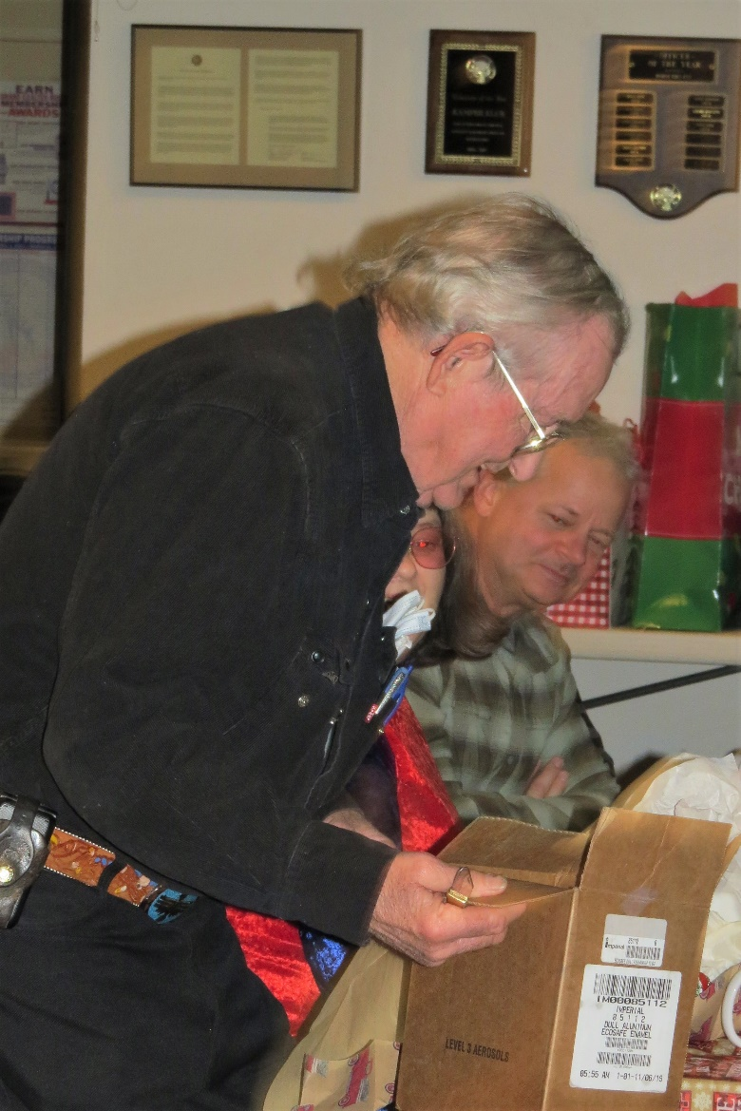
Charley busy stealing a gift.

Slide 26
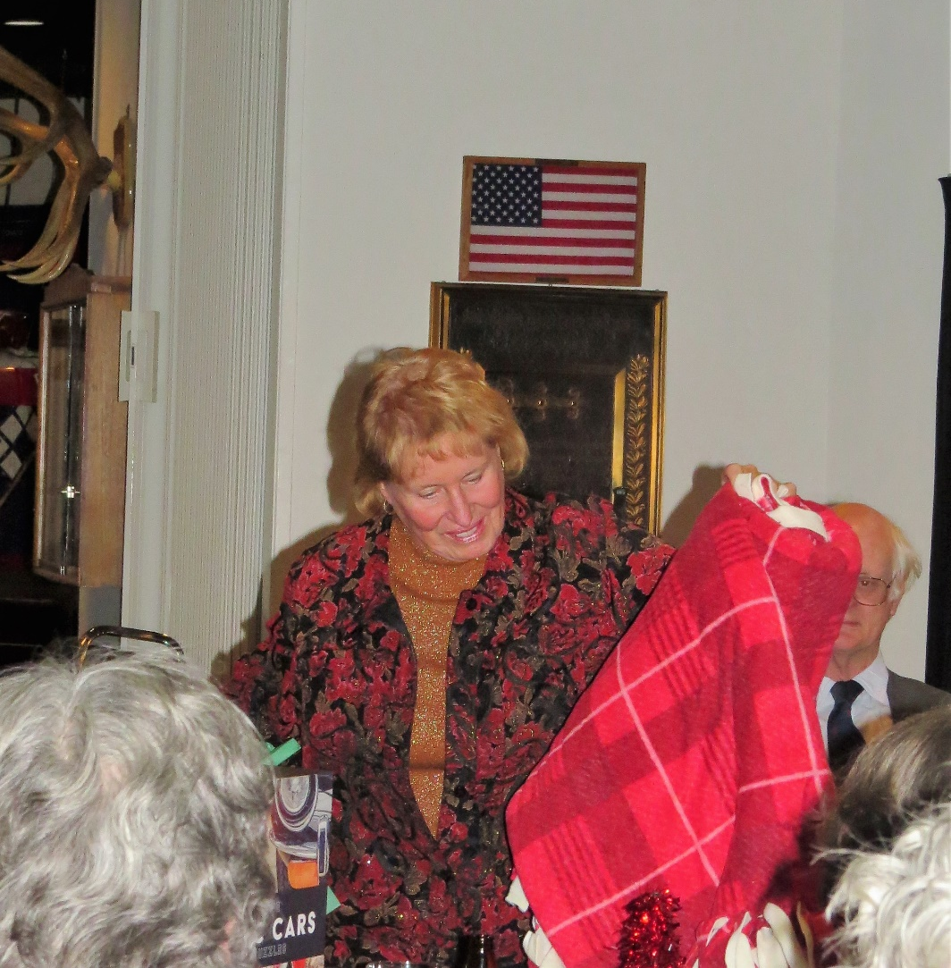
Marry picks out a throw.

Slide 27
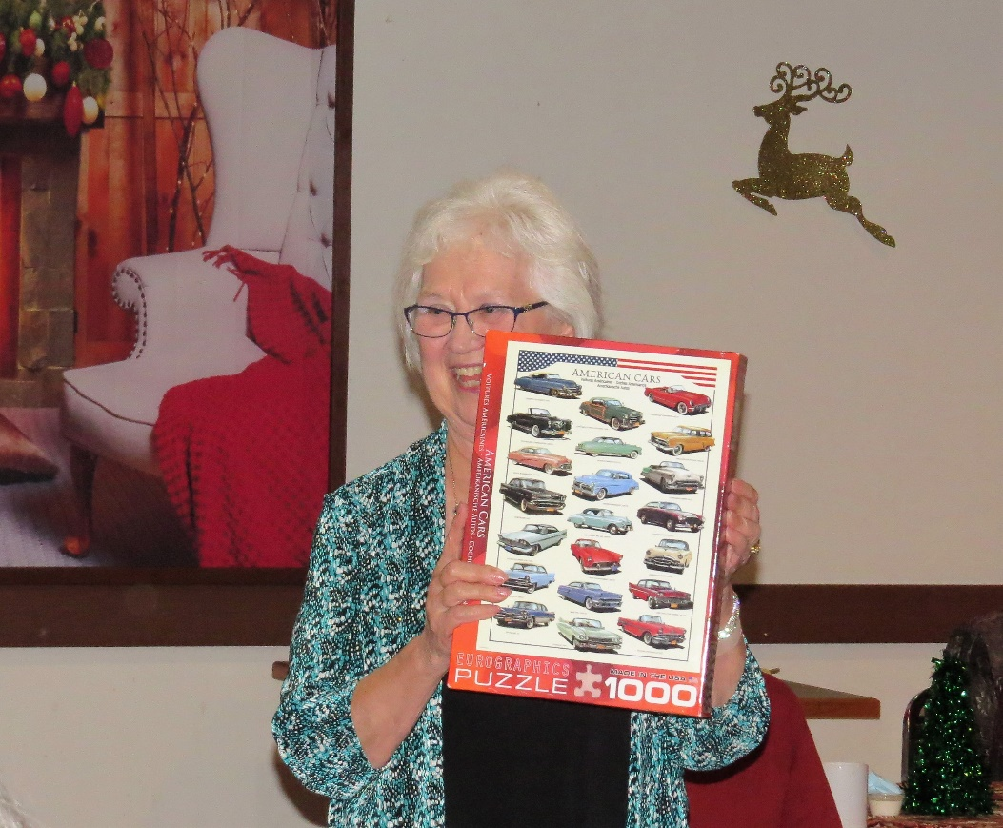
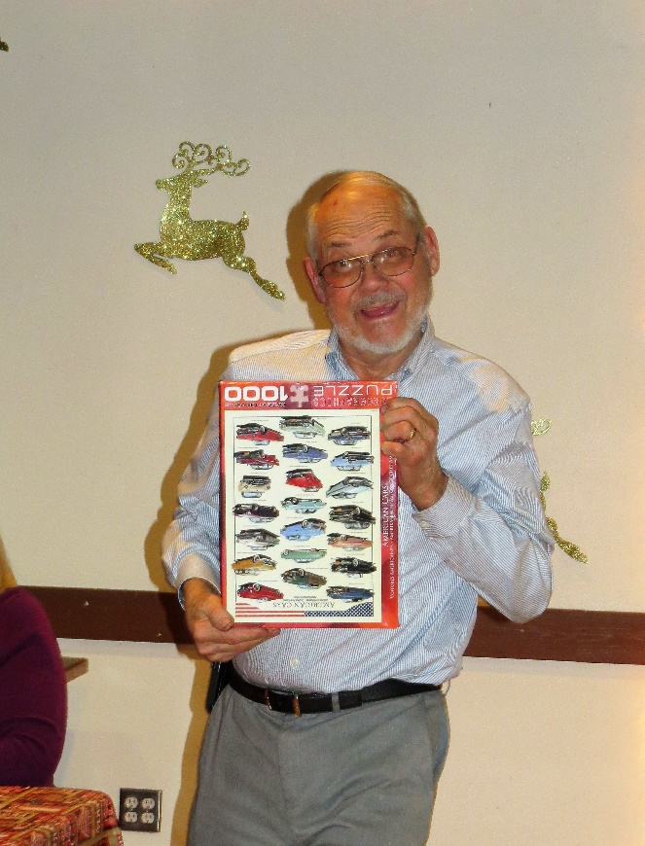
Ruth picks a car puzzle
And Gary steals it…

Slide 28
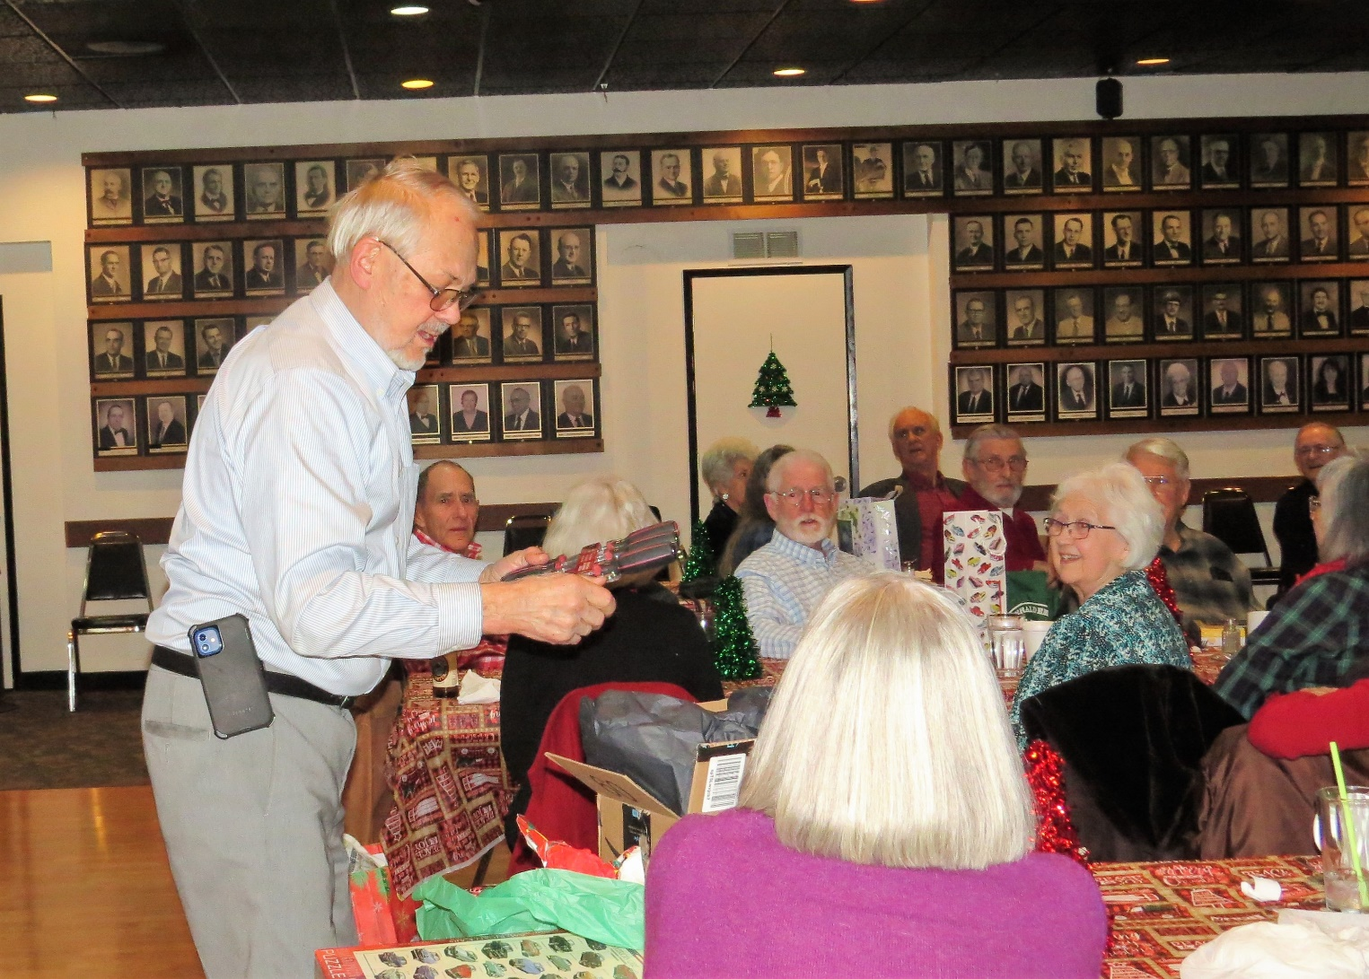
Garry is on the steal again!
.

Slide 29
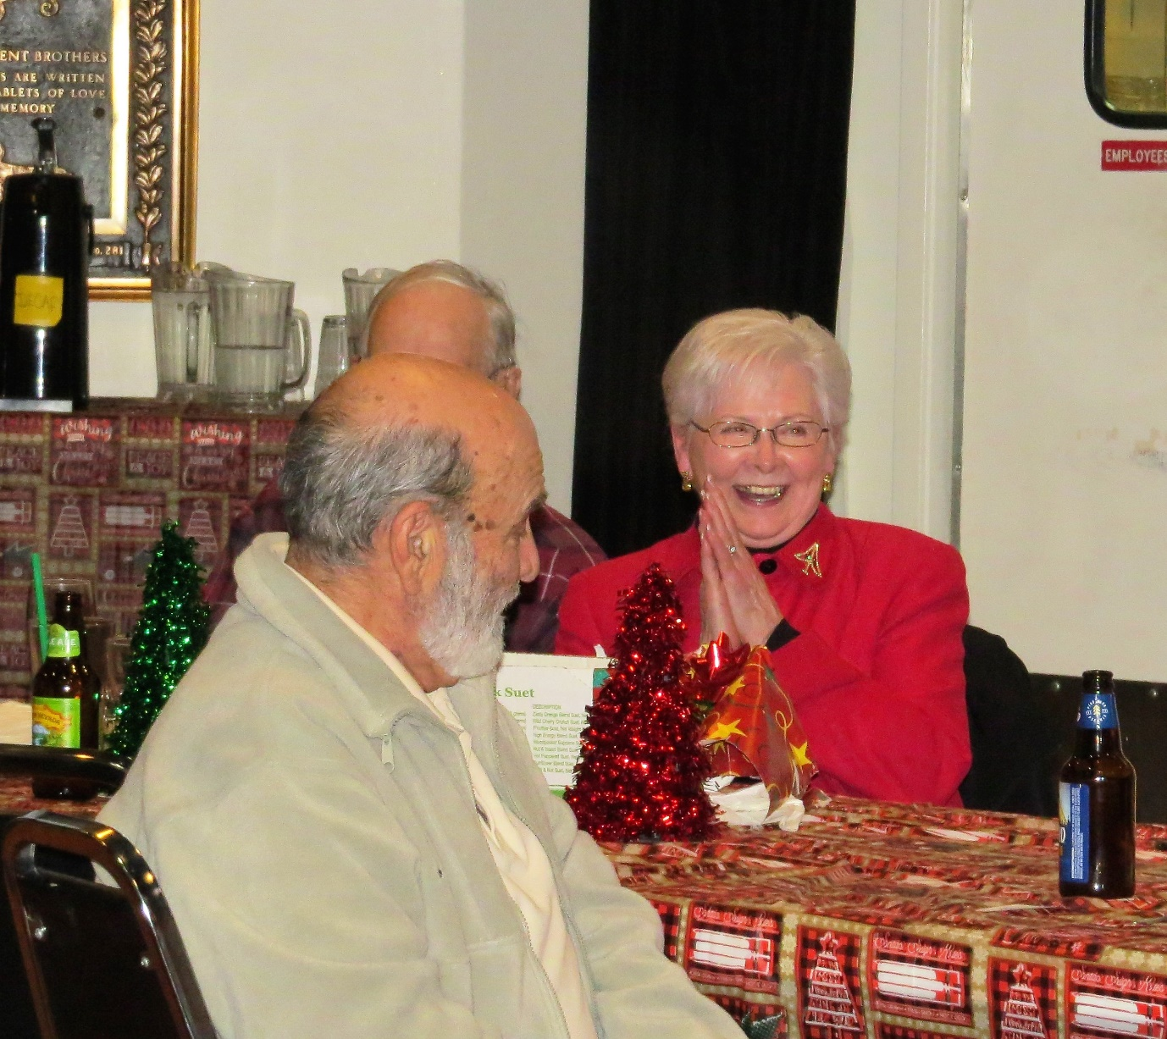
Sylvia was having a good laugh

Slide 30
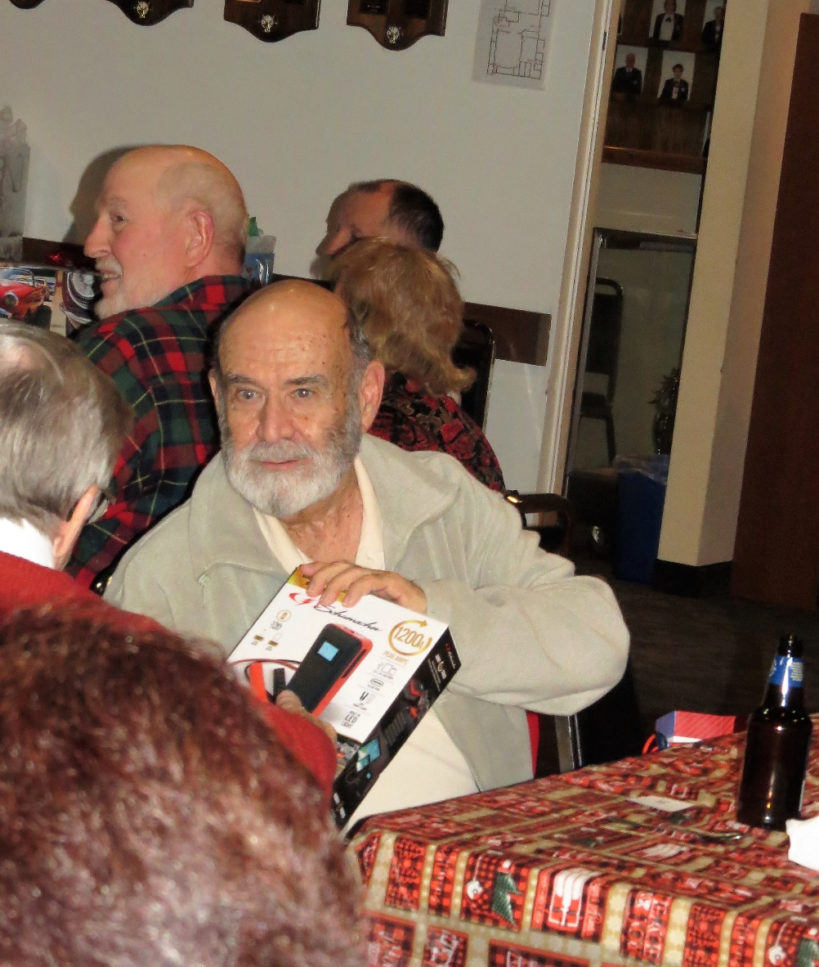
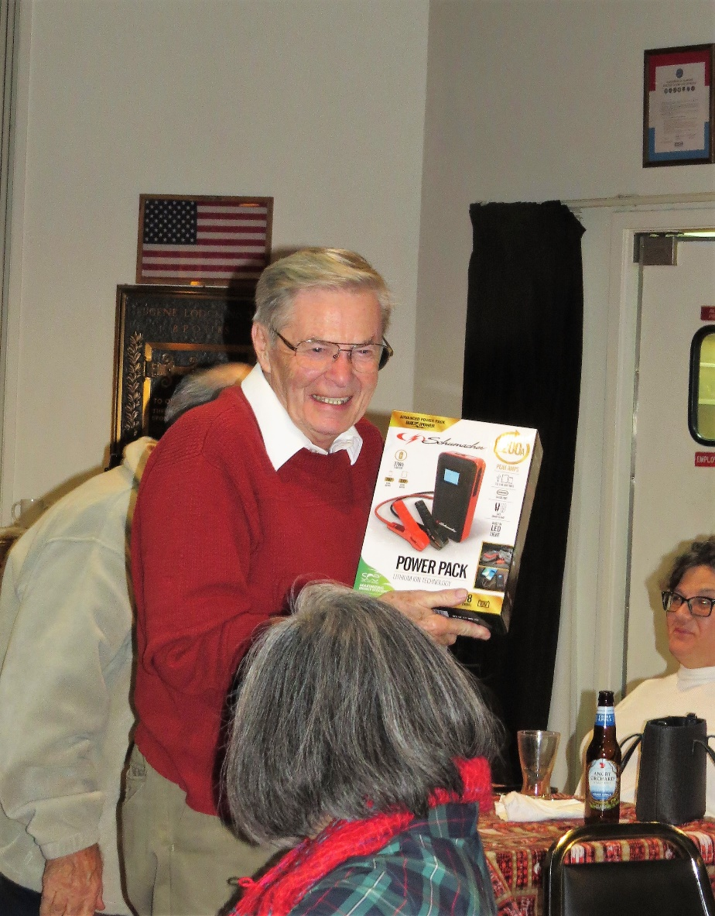
Rudy scored with a battery jumper
George Steals it..

Slide 31
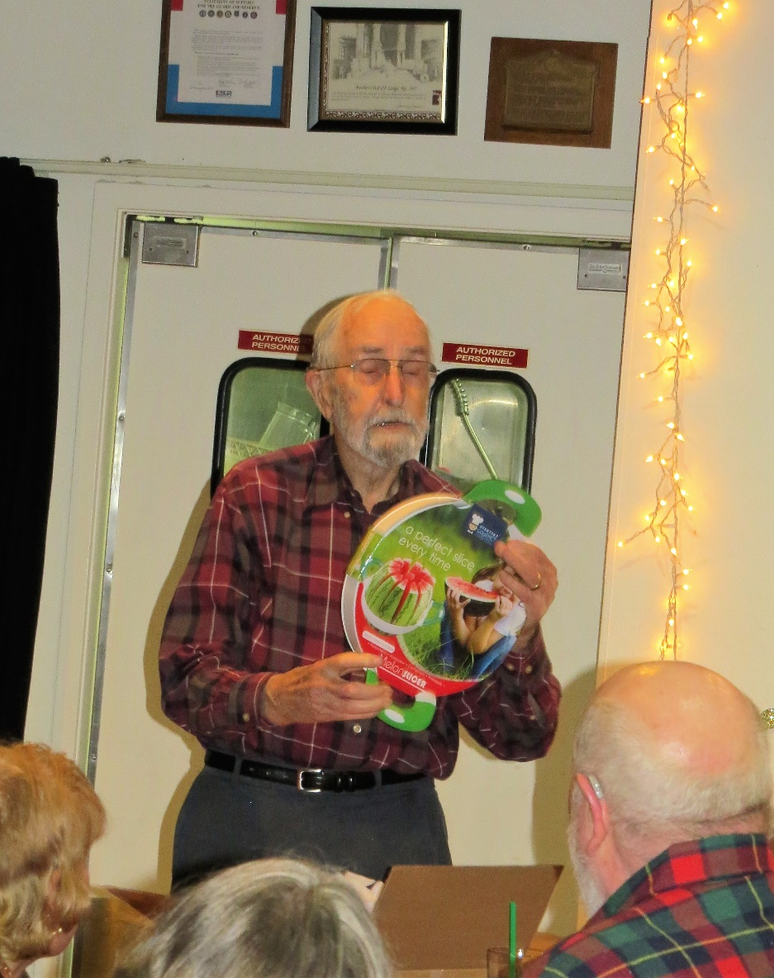
George picked a watermelon cutting board but later lost it….

Slide 32
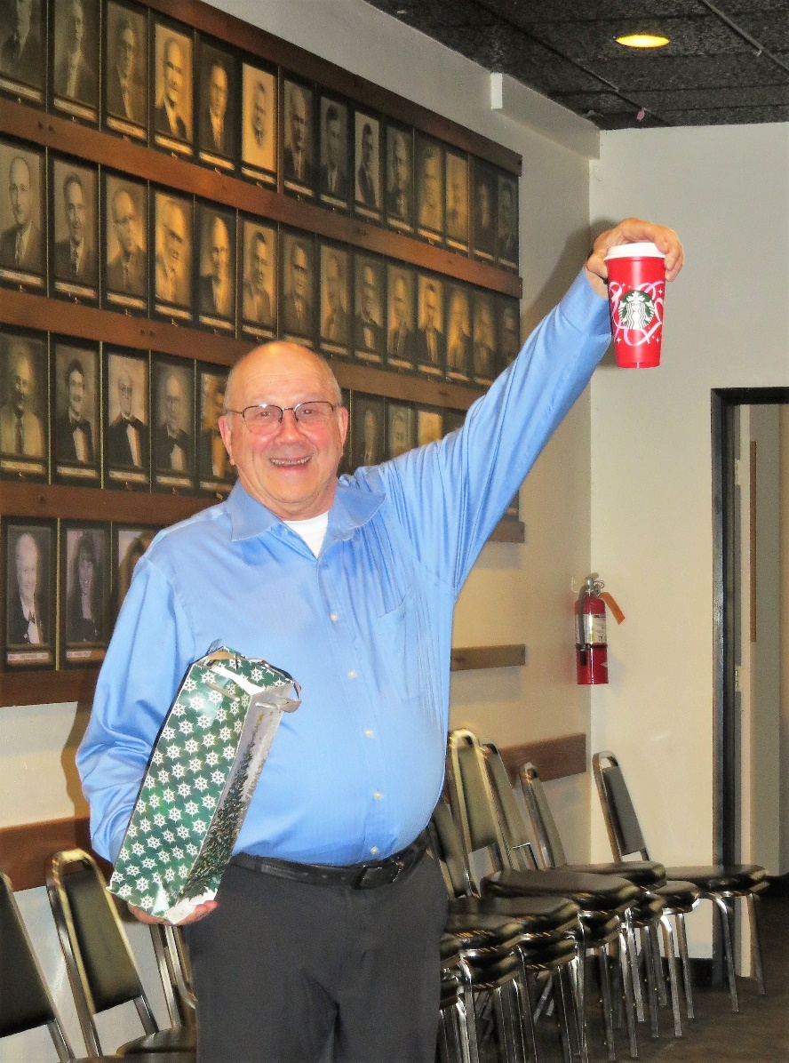
Not sure what Byron has there but it got stolen too..

Slide 33
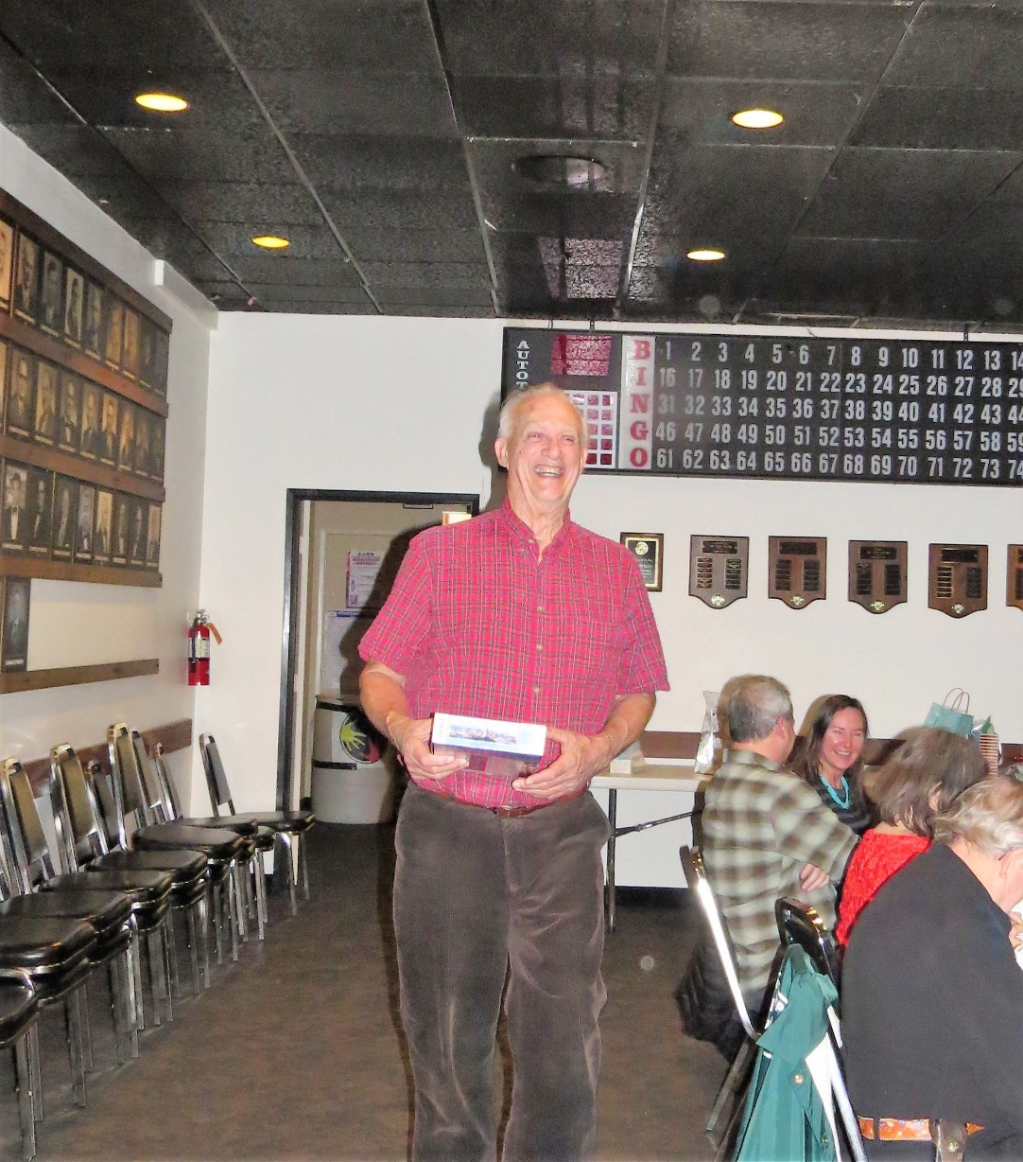

Slide 34
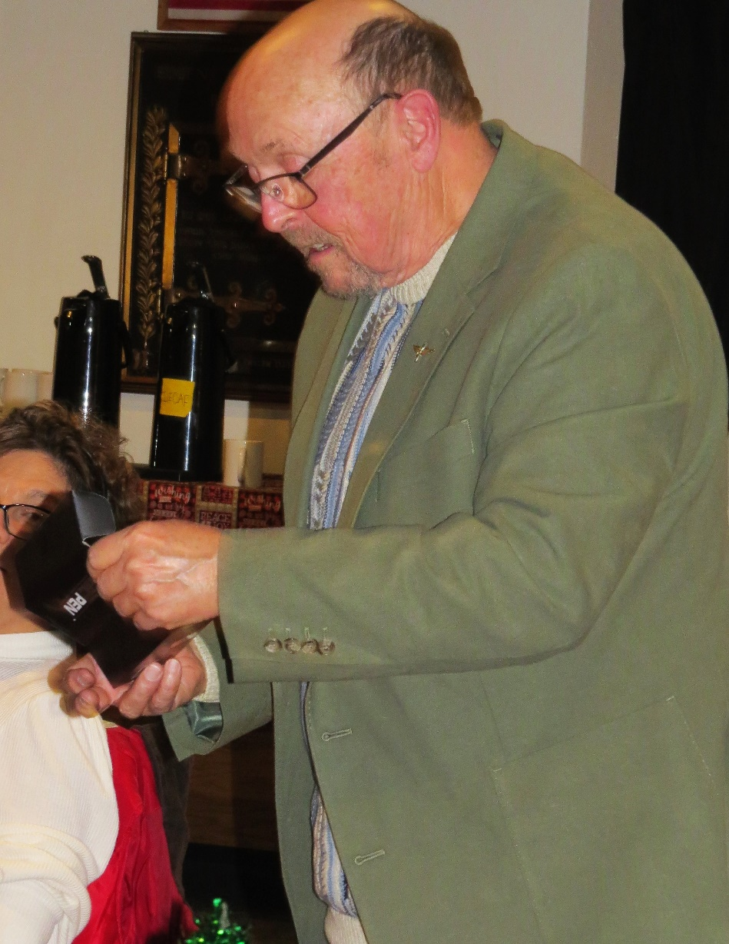
Jim’s not sure what he got but thinks it might be a Taser

Slide 35
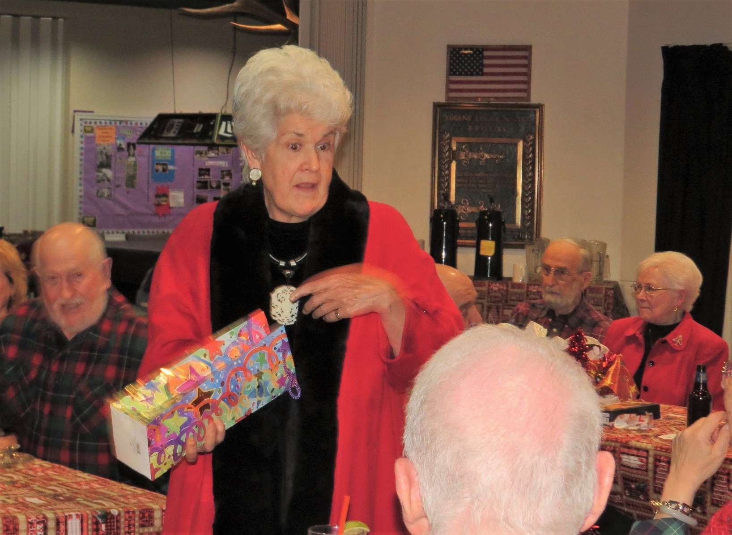
Hmm, think more stealing went on than picking out gifts…

Slide 36


I think everyone had a good time

Slide 37
Big thanks to all those who worked to put on a wonderful Christmas Dinner Party
And thanks to Ann for providing the photos..
Merry Christmas and Healthy and Happy New Year

